Slide 1

EE450 Discussion #3
September 8, 2010
Chapter 2 Application Layer
-Application layer: HTTP, FTP, SMTP
-WireShark (Formerly known as Ethereal)
Computer Networking: A Top Down Approach Featuring the Internet,
3rd edition.
Jim Kurose, Keith Ross
Addison-Wesley, July 2004.
All material copyright 1996-2005
J.F Kurose and K.W. Ross, All Rights Reserved

Slide 2
Some network applications
E-mail
Web
Instant messaging
Remote login
P2P file sharing
Multi-user network games
Streaming stored video clips
Internet telephone
Real-time video conference
Massive parallel computing

Slide 3





Creating a network app
Write programs that
  run on different end systems and
  communicate over a network.
  e.g., Web: Web server software communicates with browser software
little software written for devices in network core
  network core devices do not run user application code
  application on end systems allows for rapid app development, propagation
application
transport
network
data link
physical
application
transport
network
data link
physical
application
transport
network
data link
physical

Slide 4
Application architectures
Client-server
Peer-to-peer (P2P)
Hybrid of client-server and P2P

Slide 5
Client-server architecture
server:
  always-on host
  permanent IP address
  server farms for scaling
clients:
  communicate with server
  may be intermittently connected
  may have dynamic IP addresses
  do not communicate directly with each other

Slide 6
Pure P2P architecture
no always-on server
arbitrary end systems directly communicate
peers are intermittently connected and change IP addresses
example: Gnutella
Highly scalable
But difficult to manage

Slide 7
Hybrid of client-server and P2P
Napster
  File transfer P2P
  File search centralized:
    Peers register content at central server
    Peers query same central server to locate content
Instant messaging
  Chatting between two users is P2P
  Presence detection/location centralized:
    User registers its IP address with central server when it comes online
    User contacts central server to find IP addresses of buddies

Slide 8
Processes communicating
Process: program running within a host.
within same host, two processes communicate using inter-process communication (defined by OS).
processes in different hosts communicate by exchanging messages
Client process: process that initiates communication
Server process: process that waits to be contacted
Note: applications with P2P architectures have client processes & server processes

Slide 9
Web and HTTP
First some jargon
Web page consists of objects
Object can be HTML file, JPEG image, Java applet, audio file,…
Web page consists of base HTML-file which includes several referenced objects
Each object is addressable by a URL
Example URL:
www.someschool.edu/someDept/pic.gif
host name
path name

Slide 10
HTTP overview
HTTP: hypertext transfer protocol
Web’s application layer protocol
client/server model
  client: browser that requests, receives, “displays” Web objects
  server: Web server sends objects in response to requests
HTTP 1.0: RFC 1945
HTTP 1.1: RFC 2068
HTTP request
PC running
Explorer
HTTP response
HTTP request
Server
running
Apache Web
server
HTTP response
Mac running
Navigator

Slide 11
HTTP overview (continued)
Uses TCP:
client initiates TCP connection (creates socket) to server, port 80
server accepts TCP connection from client
HTTP messages (application-layer protocol messages) exchanged between browser (HTTP client) and Web server (HTTP server)
TCP connection closed
HTTP is “stateless”
server maintains no information about past client requests
aside
Protocols that maintain “state” are complex!
past history (state) must be maintained
if server/client crashes, their views of “state” may be inconsistent, must be reconciled

Slide 12
HTTP connections
Nonpersistent HTTP
At most one object is sent over a TCP connection.
HTTP/1.0 uses nonpersistent HTTP
Persistent HTTP
Multiple objects can be sent over single TCP connection between client and server.
HTTP/1.1 uses persistent connections in default mode

Slide 13
Nonpersistent HTTP
(contains text,
references to 10
jpeg images)
Suppose user enters URL www.someSchool.edu/someDepartment/home.index
1a. HTTP client initiates TCP connection to HTTP server (process) at www.someSchool.edu on port 80
1b. HTTP server at host www.someSchool.edu waiting for TCP connection at port 80. “accepts” connection, notifying client
2. HTTP client sends HTTP request message (containing URL) into TCP connection socket. Message indicates that client wants object someDepartment/home.index
3. HTTP server receives request message, forms response message containing requested object, and sends message into its socket
time

Slide 14
Nonpersistent HTTP (cont.)
4. HTTP server closes TCP connection.
5. HTTP client receives response message containing html file, displays html. Parsing html file, finds 10 referenced jpeg objects
time
6. Steps 1-5 repeated for each of 10 jpeg objects

Slide 15
Response time modeling
Definition of RTT: time to send a small packet to travel from client to server and back.
Response time:
one RTT to initiate TCP connection
one RTT for HTTP request and first few bytes of HTTP response to return
file transmission time
total = 2RTT+transmit time
initiate TCP
connection
RTT
request
file
RTT
time to
transmit
file
file
received
time
time

Slide 16
Persistent HTTP
Nonpersistent HTTP issues:
requires 2 RTTs per object
OS overhead for each TCP connection
browsers often open parallel TCP connections to fetch referenced objects
Persistent HTTP
server leaves connection open after sending response
subsequent HTTP messages between same client/server sent over open connection
Persistent without pipelining:
client issues new request only when previous response has been received
one RTT for each referenced object
Persistent with pipelining:
default in HTTP/1.1
client sends requests as soon as it encounters a referenced object
as little as one RTT for all the referenced objects

Slide 17
HTTP request message
two types of HTTP messages: request, response
HTTP request message:
  ASCII (human-readable format)
request line
(GET, POST,
HEAD commands)
GET /somedir/page.html HTTP/1.1
Host: www.someschool.edu
User-agent: Mozilla/4.0
Connection: close
Accept-language:fr
(extra carriage return, line feed)
header
lines
Carriage return,
line feed
indicates end
of message

Slide 18
HTTP response message
status line
(protocol
status code
status phrase)
HTTP/1.1 200 OK
Connection close
Date: Thu, 06 Aug 1998 12:00:15 GMT
Server: Apache/1.3.0 (Unix)
Last-Modified: Mon, 22 Jun 1998 …...
Content-Length: 6821
Content-Type: text/html
data data data data data ...
header
lines
data, e.g.,
requested
HTML file

Slide 19
HTTP response status codes
In first line in server->client response message.
A few sample codes:
200 OK
  request succeeded, requested object later in this message
301 Moved Permanently
  requested object moved, new location specified later in this message (Location:)
400 Bad Request
  request message not understood by server
404 Not Found
  requested document not found on this server
505 HTTP Version Not Supported

Slide 20
Trying out HTTP (client side) for yourself
1. Telnet to your favorite Web server:
telnet cis.poly.edu 80
Opens TCP connection to port 80
(default HTTP server port) at cis.poly.edu.
Anything typed in sent
to port 80 at cis.poly.edu
2. Type in a GET HTTP request:
GET /~ross/ HTTP/1.1
Host: cis.poly.edu
By typing this in (hit carriage
return twice), you send
this minimal (but complete)
GET request to HTTP server
3. Look at response message sent by HTTP server!

Slide 21

FTP: the file transfer protocol
FTP
user
interface
FTP
client
file transfer
FTP
server
user
at host
local file
system
remote file
system
transfer file to/from remote host
client/server model
  client: side that initiates transfer (either to/from remote)
  server: remote host
ftp: RFC 959
ftp server: port 21

Slide 22
FTP: separate control, data connections
TCP control connection
port 21
FTP client contacts FTP server at port 21, specifying TCP as transport protocol
Client obtains authorization over control connection
Client browses remote directory by sending commands over control connection.
When server receives a command for a file transfer, the server opens a TCP data connection to client
After transferring one file, server closes connection.
FTP
client
TCP data connection
port 20
FTP
server
Server opens a second TCP data connection to transfer another file.
Control connection: “out of band”
FTP server maintains “state”: current directory, earlier authentication

Slide 23
FTP commands, responses
Sample commands:
sent as ASCII text over control channel
USER username
PASS password
LIST return list of file in current directory
RETR filename retrieves (gets) file
STOR filename stores (puts) file onto remote host
Sample return codes
status code and phrase (as in HTTP)
331 Username OK, password required
125 data connection already open; transfer starting
425 Can’t open data connection
452 Error writing file

Slide 24
Electronic Mail
outgoing
message queue
user mailbox
Three major components:
user agents
mail servers
simple mail transfer protocol: SMTP
User Agent
a.k.a. “mail reader”
composing, editing, reading mail messages
e.g., Eudora, Outlook, elm, Netscape Messenger
outgoing, incoming messages stored on server
user
agent
mail
server
user
agent
SMTP
mail
server
user
agent
SMTP
SMTP
mail
server
user
agent
user
agent
user
agent

Slide 25
Electronic Mail: mail servers
Mail Servers
mailbox contains incoming messages for user
message queue of outgoing (to be sent) mail messages
SMTP protocol between mail servers to send email messages
  client: sending mail server
  “server”: receiving mail server
user
agent
mail
server
user
agent
SMTP
mail
server
user
agent
SMTP
SMTP
mail
server
user
agent
user
agent
user
agent

Slide 26
Electronic Mail: SMTP [RFC 2821]
uses TCP to reliably transfer email message from client to server, port 25
direct transfer: sending server to receiving server
three phases of transfer
  handshaking (greeting)
  transfer of messages
  closure
command/response interaction
  commands: ASCII text
  response: status code and phrase
messages must be in 7-bit ASCII

Slide 27

Scenario: Alice sends message to Bob
1) Alice uses UA to compose message and “to” bob@someschool.edu
2) Alice’s UA sends message to her mail server; message placed in message queue
3) Client side of SMTP opens TCP connection with Bob’s mail server
4) SMTP client sends Alice’s message over the TCP connection
5) Bob’s mail server places the message in Bob’s mailbox
6) Bob invokes his user agent to read message
1
mail
server
mail
server
user
agent
user
agent
2
3
6
4
5

Slide 28
Try SMTP interaction for yourself:
telnet servername 25
see 220 reply from server
enter HELO, MAIL FROM, RCPT TO, DATA, QUIT commands
This lets you send email without using email client (reader)

Slide 29
Mail access protocols
SMTP
SMTP
access
protocol
user
agent
user
agent
sender’s mail
server
receiver’s mail
server
SMTP: delivery/storage to receiver’s server
Mail access protocol: retrieval from server
  POP: Post Office Protocol [RFC 1939]
    authorization (agent <-->server) and download
  IMAP: Internet Mail Access Protocol [RFC 1730]
    more features (more complex)
    manipulation of stored msgs on server
  HTTP: Hotmail , Yahoo! Mail, etc.

Slide 30


Formerly known as ETHEREAL
A Brief Introduction To

Slide 31
So Ethereal, Is it?
Actually, it’s WireShark to you! ☺
A powerful GUI based Network Protocol Analyzer
Runs on common o/s platforms: Linux, Unix, Mac, MS Windows
Provides the ability to directly analyze network communications on your PC
Supports most protocols and media, more than 472 currently
It is free!

Slide 32
What it does:
Allows interactive examination of data arriving at, and leaving from, the Network Adapter on your host machine
Displays source and destination IP addresses, ports, message types, and message contents
Also allows selective filtering of particular frames for specific analysis

Slide 33
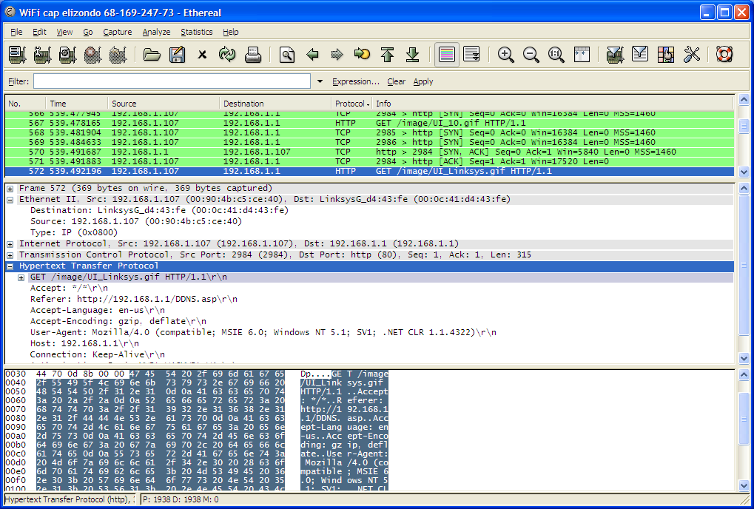
Screen shot of the GUI
List of captured frames
Encapsulation of selected frame
Raw data from Physical (PHY) layer in HEX plus ASCII Text equivalent

Slide 34
Screenshot presents the intercepted data in Hexadecimal representation at bottom of screen (Binary would not be efficient for display purposes!)
Shows the encapsulation of different layers of the communication: addressing, ports, message type, payload
Can expand (decodes or translates) each part of protocol into form meaningful to humans
Particular example shows GET image request

Slide 35
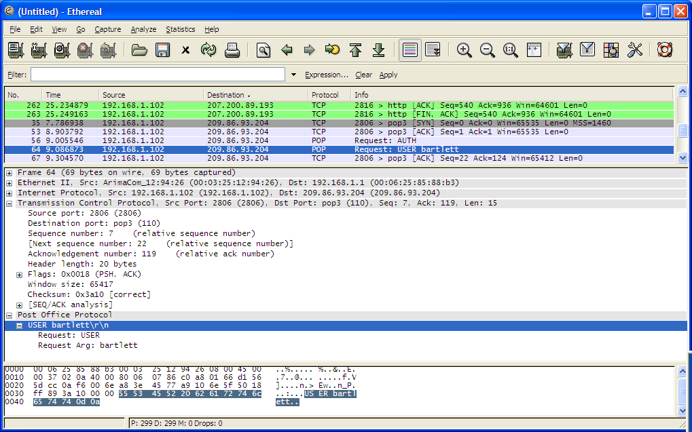
Example of connection to email server
IP address of Earthlinks’ mail server 209.86.93.204
Assigned ports on mail server (110) and on my PC (2806)

Slide 36
Email server connection comments
The frame (#64 in this capture) shows that it is 69 bytes in length
This particular frame is part of a connection to an email server using Post-Office-Protocol
This is a request to the mail server identifying my user name
You can see the destination port on the mail server is 110 (a good example of a well known port number), and the port opened on my machine is 2806
Notice the Checksum field and Window size

Slide 37
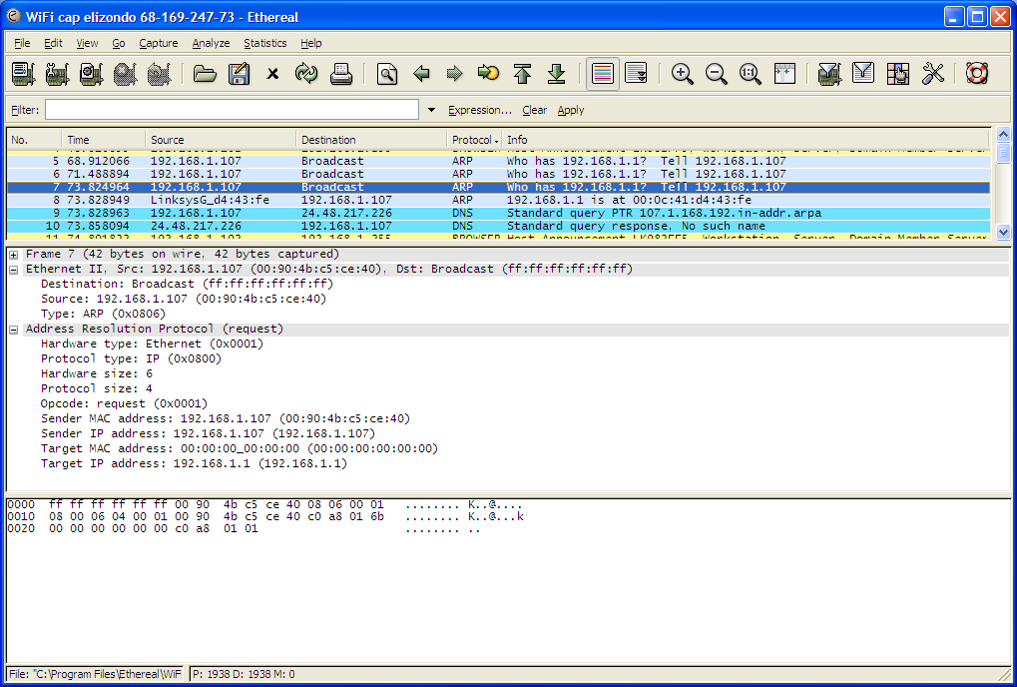
Example of Address Resolution Protocol event (housekeeping)
Destination: ff.ff.ff.ff.ff.ff
My machines’ MAC and IP addresses

Slide 38
Details of ARP event
An example of how the network finds out MAC addresses
In the first slide, my machine is trying to find the MAC address of 192.168.1.1 (default router)
So it sends a “WHO HAS” broadcast message to MAC address ff.ff.ff.ff.ff.ff
Part of the message frame contains my machine’s MAC address, hopefully for the default router to reply to

Slide 39
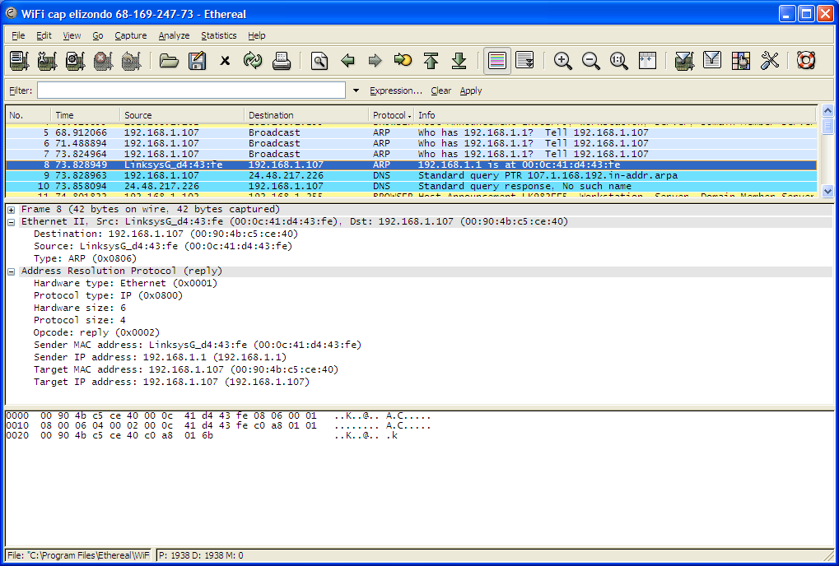
ARP continuation
“Reply” from default router to my machine identifying its MAC address

Slide 40
ARP continued..
The very next frame is the reply from the router telling my machine of the router’s MAC address
From this point onwards, both MAC addresses are known and therefore frames can be transferred by the Data Link Layer
This shows how new nodes joining a network gain membership through Address Resolution Protocol

Slide 41
How Ethereal works
Puts the Network Adapter into Promiscuous mode
Forces interface not to drop any frames
Thus it allows all frames to be captured…
And viewed
If this particular machine was on a simple switch then all traffic to / from other machines would also be visible…

Slide 42
Some more useful features
Can capture traffic to a file for later analysis and filtering
Useful when trying to debug or trace problems with networks or find malware
Can filter traffic by IP and port number etc
Can perform statistical analysis of captured frames

Slide 43
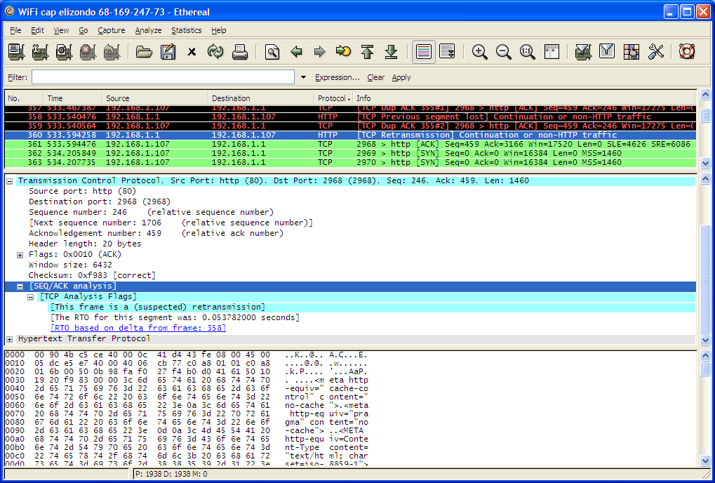
Example of WiFi traffic

Slide 44
The previous slide shows a suspected retransmission of a frame.
This particular traffic was captured from a wireless LAN belonging to a neighbor that I am within range of.
As the signal strength is rather low, the connection integrity is rather poor leading to data corruption errors – lots of retries.

Slide 45
PING
An example of Internet Control Message Protocol (ICMP)
Used to find out if a host is ‘reachable’
Run from CMD prompt on PC
C:\> ping 209.86.93.204

Slide 46
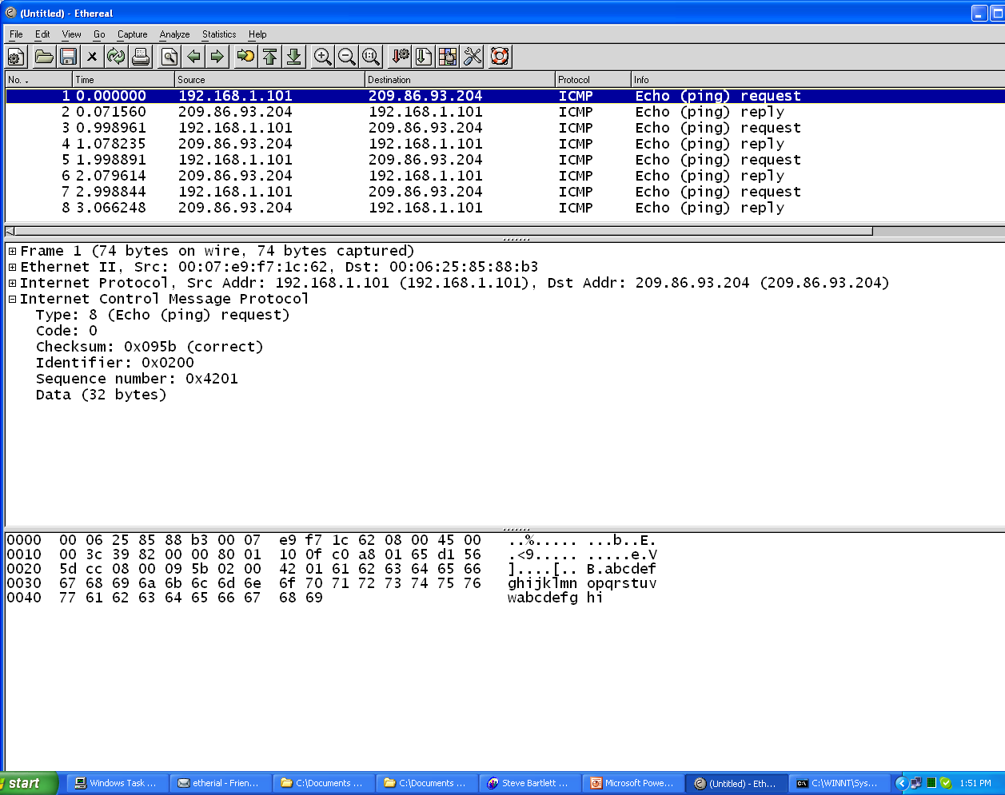
Ping 209.86.93.204

Slide 47
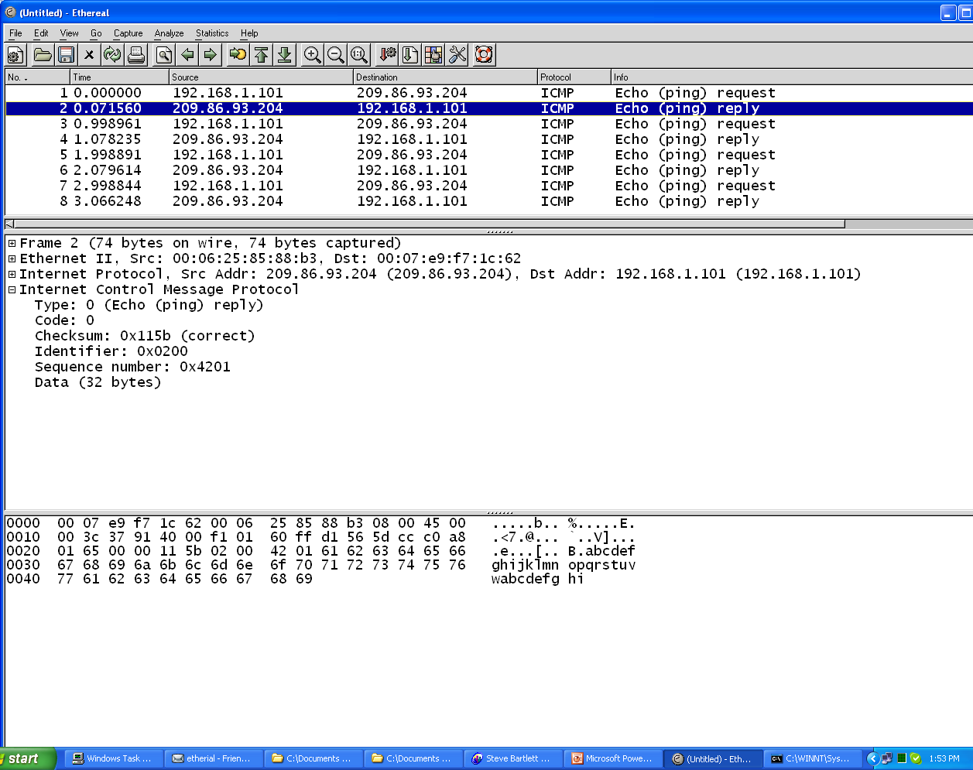
Ping reply

Slide 48
First slide shows PING request
Sends 32 bytes of data abcdefghijkl…
Recipient responds back with data
Provides measurement of loopback time
Can also be used to illustrate DNS operation – see next slide

Slide 49
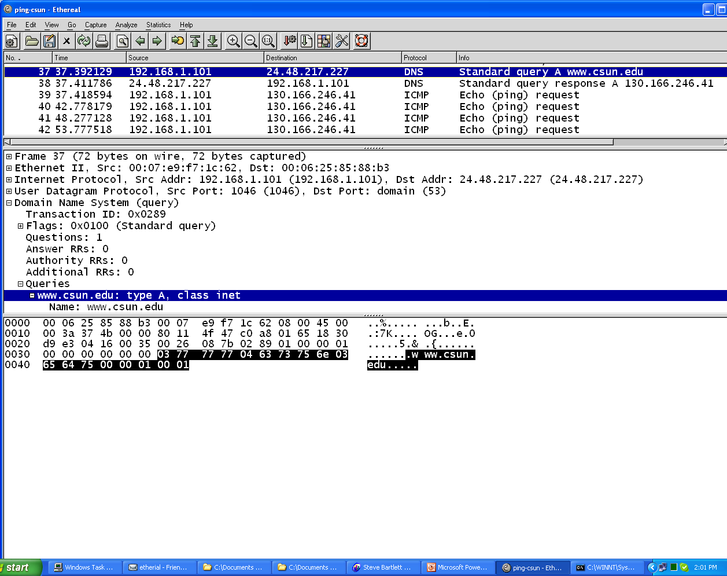
PING www.csun.edu
Name of desired host

Slide 50
Slide shows that DNS is used to find the IP address of www.csun.edu
Next frame is response from DNS with IP: 130.166.246.41
Ping can now proceed as before

Slide 51
Use case..
I found Ethereal after researching an unusually high traffic volume across my internet connection causing very slow page loads.
Turns out that my machine was infected with a virus – a hidden server was running on my machine exchanging data with some remote host
Examination of packets led to discovery of hidden server residing on my machine without my knowledge or consent!
Ethereal is a very valuable tool to have

Slide 52
Where to get it:
Visit http://www.wireshark.org/
Navigate to the ‘download’ section
Select your particular machine type (Linux, Apple, Windows etc) and choose download.
This will cause an installer executable file to download to your host.
After completion, run the executable, follow the onscreen instructions and the installation of Ethereal tools will commence.

